Slide 1
“A Reader lives a thousand lives before he dies; the man who never reads lives only one”.
- George R.R.Martin

Slide 2
• Read a variety of materials. Do not limit yourself to textbooks.
• Read a fairly long portion of the material. It would be difficult to assess reading comprehension based on one or two paragraphs. Try to read an entire section or chapter instead.
• Circle unknown or unfamiliar words as you read.
• After reading, recall as much of the information as possible. Jot down points if you like. Then check the accuracy and completeness of your recollections. If the main ideas are presented in a particular order, see if you can recall the structure.
• Consider how interesting the subject matter is and how much you already know about the subject.
• Answer questions about the material after reading it.

Slide 3
Poor comprehension skills
lack of interest,
lack of concentration,
failure to understand a word,
a sentence,
or relationships among sentences,
or failure to understand how information fits together

Slide 4
⭐ | Main Idea | What is this mainly about?
⭐⭐ | Claim → Reason → Example → Explanation | How is the main idea developed?
⭐⭐ | Inference | What does the text suggest?
⭐⭐⭐ | Audience + Purpose | Why was this written, and for whom?
⭐⭐⭐⭐ | Assumption + Evidence | What is the writer taking for granted?
⭐⭐⭐⭐ | Description → Examination → Evaluation → Judgment | Is the argument convincing?

Slide 5
A happy Anniversary Lunch and then………………

Slide 6
Test Your Comprehension
Which one of the following statements most accurately summarizes the main idea of the selection you have just finished?
1. Judge American's fourth wedding anniversary was a combination of a successful marriage and a contempt-of court citation.
2. A judge should be slow to anger and quick to forgive.
3. The first defendant that morning was a very discourteous woman.
4. The judge’s wedding anniversary was spoiled by the extra work demanded by the contempt citation.
5. There are times when judges, like other people, may overreact, and judges should remind themselves of their weaknesses in order to exercise their enormous power more judiciously.
6. Judges, like other humans, have complex hopes and expectations.

Slide 7
Dry Ice
Can you imagine ice that does not melt and is not wet? Then you can imagine dry ice. Dry ice is made by freezing a gas called carbon dioxide. Dry ice is quite different from ordinary ice, which is simply frozen water.
Dry ice was first manufactured in 1925. It has since fulfilled the fondest hopes of its inventor. It can be used for making artificial fog in the movies (when steam is passed over dry ice, a very dense vapor rises), and for destroying insects in grain supplies. It is more practical than ordinary ice because it takes up less space and is 142 degrees colder. Since it evaporates instead of melting, it is cleaner to use. For these reasons it is extremely popular, and many people prefer it to ordinary ice.
Dry ice is so cold that, if you touch it with your bare fingers, it will burn you!

Slide 8
1. Dry ice is made from water, but because it is specially treated it does not melt.
2. The first dry ice was manufactured in the 1950’s.
3. Dry ice has more uses than ordinary ice.
4. Dry ice is not as cold as ordinary ice.
5. Artificial fog can be made by passing steam over dry ice.
Notes:
F F T F T

Slide 9
An Indian Letter Carrier
Delivering mail to small villages in India was once a difficult, perilous, and exciting job. The postman travelled on foot, often wading through swamps or crawling through jungles in order to reach the many villages on his route.
The Indian mailman might sometimes encounter a fierce tiger or panther along the way, yet the only weapon he carried was a sharp spear. He never went to work without his bells, which he would shake in order (so he said) to ward off evil spirits. Wild animals or evil spirits, nothing ever interrupted his work.
The Indian letter carrier was an honoured and respected person; he was treated with great courtesy. So wise was he thought to be that he was frequently called upon to settle village disputes.
It is certainly evident that only a very brave man would take a job that compelled him to fight off wild animals in order to get his work done. You can understand why everyone in India looked upon the man who delivered mail as a true national hero.

Slide 10
An Indian mailman used to carry a gun as protection against wild animals.
2. He would also take along a set of bells to frighten off tigers and panthers.
3. The letter carrier was often asked to settle arguments in the villages that he visited.
4. Mailmen in India were considered heroes.
5. Some people in India used to believe in evil spirits.
Notes:
FFTTT

Slide 11
Rules for Faster Comprehension
1. READ MORE
Build a regular reading habit. Read books—not just short, easy material.
2. READ FOR MAIN IDEAS
Look for the writer’s central argument, theme and framework. Don’t get stuck on minor details.
3. CHALLENGE YOUR COMPREHENSION
Choose difficult material that makes you think. Growth comes from challenging reading.

Slide 12
Rules for Faster Comprehension — Practice
4. BUDGET YOUR TIME
Set a specific start and finish time. A reasonable deadline mobilizes concentration and encourages efficient reading.
5. PACE YOURSELF
Read for 15 minutes → count pages → multiply by 4 = pages/hour. Maintain that pace while protecting comprehension.
6. DEVELOP IMMEDIATE CONCENTRATION
Read purposefully for main ideas. Reading at your top comprehension speed reduces mind-wandering and keeps you engaged.
KEY PRINCIPLE: You do not become a faster reader by learning the rules—you become faster by practicing them consistently.

Slide 13

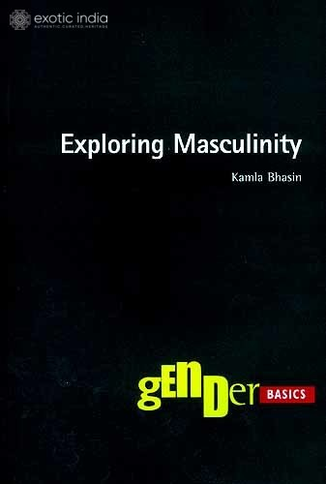

Slide 14
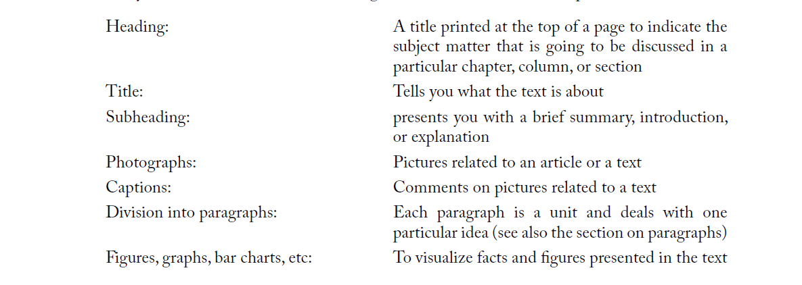

Slide 15
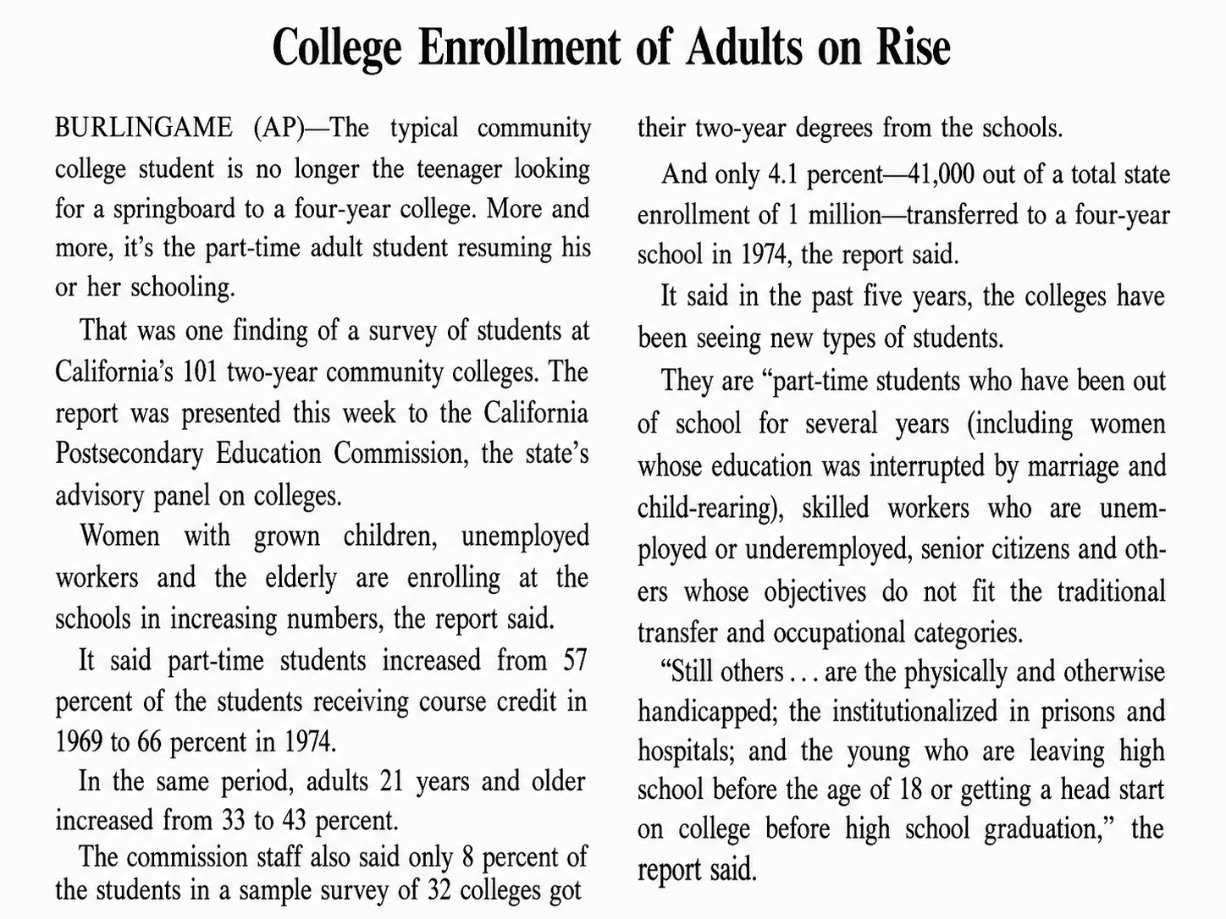

Slide 16
The typical community college student is no longer--------------------------------------------------------------- but instead is------------------------------------------------------
Notes:
Exercise 1: The typical community college student is no longer the teenager looking for a springboard to a four-year college, but instead is the part-time adult student resuming education where it was left off, or a student with special objectives who is not necessarily committed to pursuing a degree.

Slide 17
Thought and Language - by Edward Sapir
Most people, asked if they can think without speech, would probably answer, “Yes, but it is not easy for me to do so. Still, I know it can be done.” ... No one believes that even the most difficult mathematical proposition is inherently dependent on an arbitrary set of symbols, but it is impossible to suppose that the human mind is capable of arriving at or holding such a proposition without the symbolism. The writer, for one, is strongly of the opinion that the feeling entertained by so many that they can think, or even reason, without language is an illusion. The illusion seems to be due to a number of factors. The simplest of these is the failure to distinguish between imagery and thought. As a matter of fact, no sooner do we try to put an image into conscious relation with another than we find ourselves slipping into a silent flow of words. Thought may be a natural domain apart from the artificial one of speech, but speech would seem to be the only road we know that leads to it.
It is not true that __ ----------------
Notes:
It is not true that people can think without language.

Slide 18
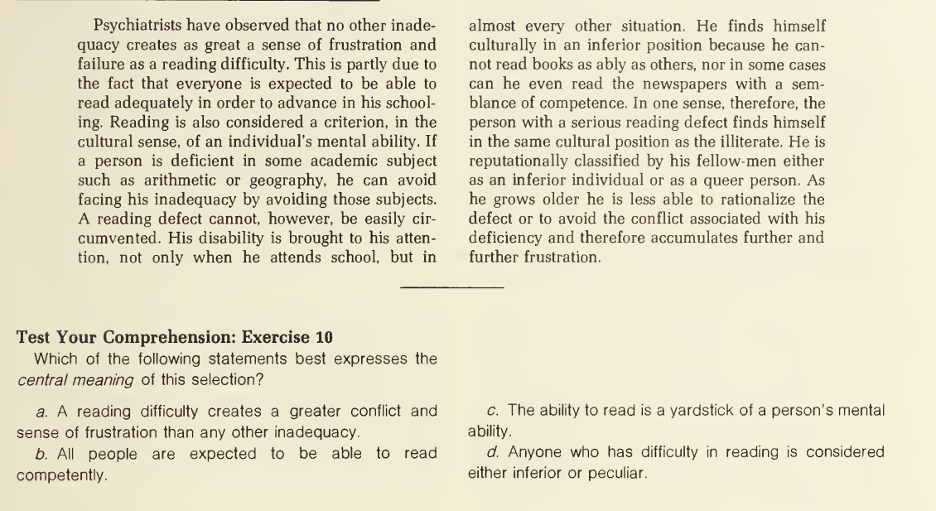

Slide 19
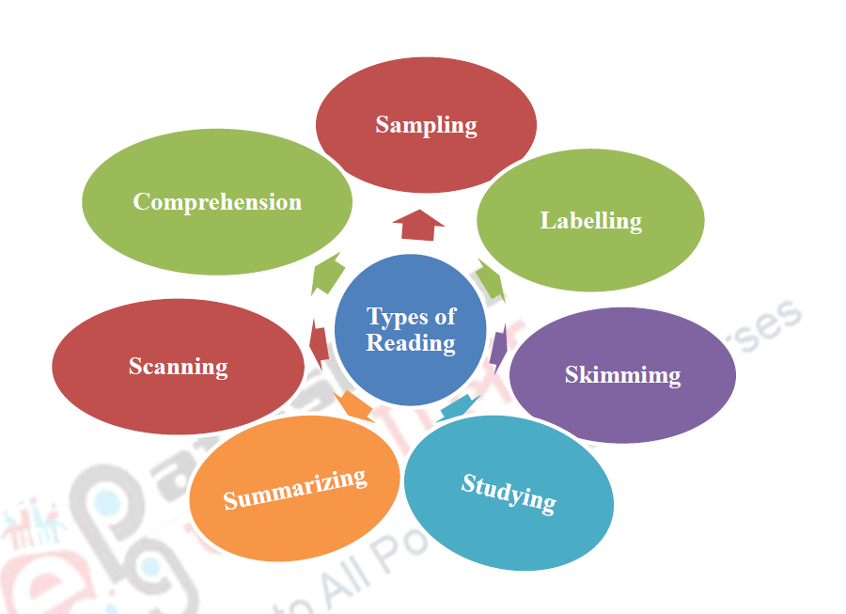

Slide 20
Type | Main question | What you do
Skimming | “What is this generally about?” | Read quickly for the overall idea
Scanning | “Where is the specific information I need?” | Search quickly for a particular fact/word
Comprehension | “What does this text mean?” | Understand the ideas and relationships
Studying | “How can I learn and remember this?” | Read carefully, analyse, make notes, revise
Summarizing | “Can I say the main points briefly?” | Reduce the text to its essential ideas
Labelling | “What does each part/section do?” | Identify and name sections, ideas, functions
Sampling | “Is this text worth reading in detail?” | Examine selected parts to judge relevance/value

Slide 21
What is Skimming?
Skimming = Getting the essence without reading everything
Reading selectively, not word-for-word
Identify:
  Main ideas
  Significant details
  Overall argument / structure
Skip information that is:
  repetitive
  merely illustrative
  less important to your purpose
Goal: maximum understanding with minimum reading
Think of skimming as removing the “padding” and finding the “skeleton” of a text.
Notes:
Skimming is useful when:
⏱️ Time is limited
📖 The text is long
🔍 You need only the main argument
📝 You are preparing for a test
🔄 You are reviewing something already read
📚 The text contains lots of background information, examples or minor details
Skimming does NOT mean careless reading.
Good skimming still requires comprehension and judgment.

Slide 22
PARTIAL SKIMMING
Read:
Main idea
Important supporting details
Necessary explanations
Information relevant to your purpose
Skip:
Repetitive examples
Minor details
Excessive background
COMPLETE SKIMMING
Read mainly:
Opening lines
Key sentences
Occasionally closing sentence
Skip:
Details
Examples
Statistics
Elaborations
Partial = understand the argument
Complete = understand the gist

Slide 23
READING SMARTER
How a good reader predicts the text before reading every word
TITLE
INTRO
BODY
CONCLUSION
What is this about?
→
What should I expect?
→
→
How is the idea developed?
So what is the point?
Prediction = faster reading + better understanding

Slide 24
THE PARAGRAPH = A MINI-ARGUMENT
Find the sentence that tells you what the paragraph is really doing.
1
2
3
TOPIC SENTENCE
SUPPORT
LINK / SUMMARY
The heart of the paragraph
What new idea is being introduced?
Arguments • explanations • details
examples • evidence
Wraps up the idea
or connects to what comes next

Slide 25
READ BETWEEN THE LINES
01 PUNCTUATION
02 AUTHOR'S VIEWPOINT
03 GUESS THE WORD
Punctuation is a
reading signal.
Watch the
word choice.
1
Word class
2
Function
Luckily / unfortunately
Probably / undoubtedly
Huge / tiny / fantastic / terrified
3
Context clues
Brackets → an addition
Commas → separate ideas/clauses
Punctuation → shows how to interpret structure
4
Familiar word
5
Best meaning
These words reveal attitude, emotion or certainty.
GOOD READERS DON'T JUST READ WORDS — THEY READ SIGNALS.
Notes:
Hyphen (-) → joins words: well-known
En dash (–) → shows a range/connection: 2010–2020
Em dash (—) → creates a strong break: I tried — but I failed.
certainly
undoubtedly
obviously
perhaps
possibly
may
might
1. Positive viewpoint
"Online education has greatly improved access to learning."
Author's viewpoint: Positive — the author thinks online education is beneficial.
2. Negative viewpoint
"Social media can have serious harmful effects on young people."
Author's viewpoint: Negative/critical — the author is concerned about social media.
3. Neutral viewpoint
"The government introduced a new policy in 2025."
Author's viewpoint: Neutral — this is mainly a factual statement without obvious judgment.

Slide 26
The 8 Principles of Skimming
When you decide to skim:
Read only enough to identify the paragraph's purpose.
If it contains a main idea → read fully.
If it contains only supporting details → skim.
Check the last sentence when necessary.
Identify the author's pattern of thinking.
You don't always need to read complete sentences.
Read thoroughly when the paragraph contains a main idea.
Follow comprehension clues that signal a change.

Slide 27
“What is this paragraph doing?”
Is it:
                Introducing
                ↓
                Explaining
                ↓
                Giving Examples
                ↓
                Presenting Evidence
                ↓
                Changing Direction
                ↓
                Drawing A Conclusion
If a paragraph is continuing the same idea, you may skim. If it is introducing something new, slow down and read carefully.

Slide 28
SIGNPOST WORDS: Know When to Skim — and When to Read
CONTINUATION
CONTRAST / CHANGE
Furthermore • Similarly • In addition
However • But • In contrast • On the other hand
Same direction → POSSIBLE SKIMMING
New direction → READ CAREFULLY
CAUSE
CONCLUSION
Because • The reason • Behind this
Therefore • Thus • In conclusion
Important explanation → READ
Likely important → READ

Slide 29
Passage on skimming
Notes:
Let us see how we apply our skimming principles to this material.
The monthly pay check of a key executive, Porter says in paragraphs 1 and 2, is surprisingly small—but his cash salary is no indication of the actual financial setup.
All this is clearly central theme material, and you read most of it.
Then, from paragraphs 3 through 7, you skim by reading only opening lines, for this section of the article contains corroborating and illustrative details that support the statements made in the first two paragraphs.
The opening lines of paragraphs 8 and 9 state that R.A. is no exception; you skip to paragraph 10, in which the central theme is extended— the fringe benefits, rather than the cash remuneration, keep executives tied to a corporation.
Paragraph 11 is a guidepost that alerts you to coming explanatory details, and these you pick up by skimming paragraphs 12 through 15, realizing, as you read, that these details for the most part are a repetition of those found in paragraphs 3-7.
In paragraphs 16 and 17 you recognize a recapitulation of the piece, including a restatement of the central theme, and so you read more or less fully.
Thus, having read, in full, only paragraphs 1, 2, 10, 11, 16, and 17—six paragraphs out of seventeen—you have a clear understanding of what the author has said and of the pattern in which she has said it.
Fringe benefits, such as expense accounts, retirement programs, stock options, deferred bonuses, etc., are more the yardstick of remuneration to executives than their actual pay checks; and these keep the executives all but immune to offers from competitive corporations—this is the gist of the piece.
Central theme; supporting details; extension of the theme; more details; recapitulation—this is the structure of the author’s thinking, a structure to which you are keenly alert as you skim through the content.
What have you lost by partial skimming? A certain richness of detail and explanation, mainly, which you must expect to sacrifice whenever you skim—and very little else. If this richness were important to you, or if you had some special interest in every bit of information, no matter how minor, that the selection contained—why, then, of course, you would not skim it.

Slide 30
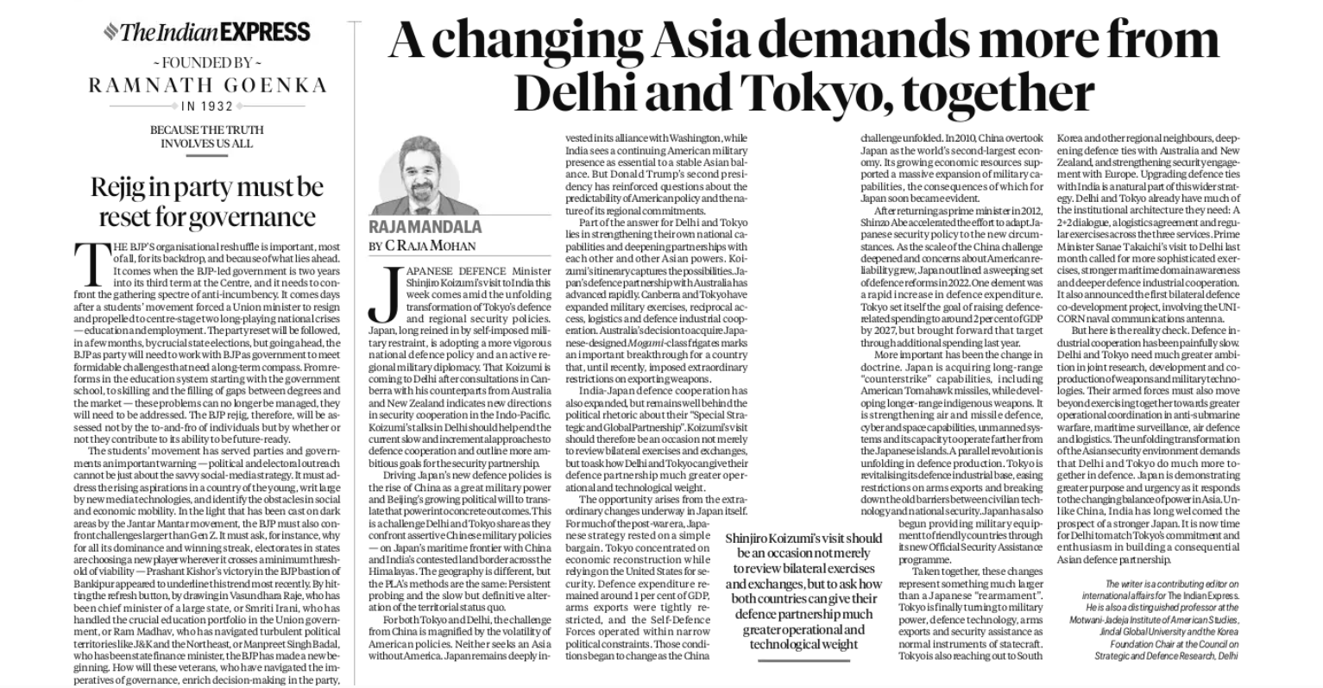

Slide 31
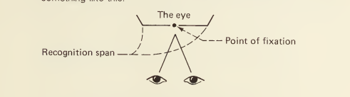

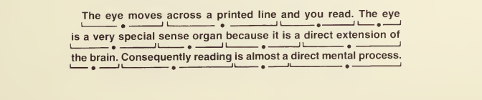

Slide 32
SQ3R: Read Smarter, Not Longer
1
SURVEY
Preview the text
Title • headings • summary • visuals
2
QUESTION
Ask what you want
to discover
3
READ
Read actively
Focus on main ideas
4
RECITE
Close the book
Explain it in your own words
5
REVIEW
Test yourself
Check what you remember
Think of SQ3R as a conversation with the text: Preview → Ask → Read → Explain → Check
Notes:
Survey: What is this article probably about?
↓
Question: What is the author's main argument?
↓
Read: Find the claim, reasons and evidence.
↓
Recite: Explain the author's argument without looking at the text.
↓
Review: Is the argument convincing? What assumptions does the author make?

Slide 33
When Forests Disappear
Forests are often described as the lungs of the planet, but their importance extends far beyond the production of oxygen. Forest ecosystems regulate water cycles, protect soil from erosion, store carbon, and provide habitats for countless species. They also support the livelihoods of millions of people who depend on forests for food, medicine, fuel, and income. Despite these benefits, forests continue to disappear in many parts of the world because of agriculture, mining, urban expansion, and commercial logging. Deforestation does not simply remove trees; it can disturb an entire ecological system. When trees are cleared, rainfall may wash away fertile soil, rivers can become polluted with sediment, and local temperatures may rise. Animals that depend on particular trees or forest habitats may be forced to migrate or may fail to survive. The loss of biodiversity can then affect other species, creating consequences that are difficult to predict. Some argue that forests must be protected regardless of economic cost. Others point out that communities and developing economies need land and natural resources to improve living standards. The real challenge, therefore, is not merely to stop human activity but to find ways of meeting human needs without destroying the ecological systems on which those needs ultimately depend. Sustainable forestry, reforestation, protected areas, and responsible land-use planning can help achieve this balance. However, such measures require long-term thinking. A forest that takes decades to recover cannot be treated as though it were an unlimited resource. Protecting forests ultimately requires society to recognise that economic progress and environmental health are not necessarily opposing goals; when managed wisely, they can support each other.
Notes:
S — SURVEY 👀
Before reading, students look at the title and four paragraphs.
Ask:
What problem is likely to be discussed?
What causes the problem?
Will the author present only one side?
Q — QUESTION ❓
Students create questions such as:
Why are forests important?
What happens when forests disappear?
Why do people continue to cut down forests?
Is economic development necessarily opposed to environmental protection?
What solutions does the author suggest?
R — READ 📖
While reading, identify:
Main idea → Causes → Effects → Different viewpoints → Solutions → Author's conclusion
R — RECITE / RECALL 🗣️
Close the passage and complete:
Forests are important because ____________. Deforestation can lead to ____________. Although people need natural resources for ____________, the author suggests that ____________.
R — REVIEW 🔄
What is the central argument?
Give three ecological benefits of forests.
What are two consequences of deforestation?
Why might some people support continued use of forest resources?
What does the author mean by “long-term thinking”?
What solutions are suggested?
What is the author's viewpoint?
Is the author strongly against economic development, or does the author take a balanced position?

Slide 34
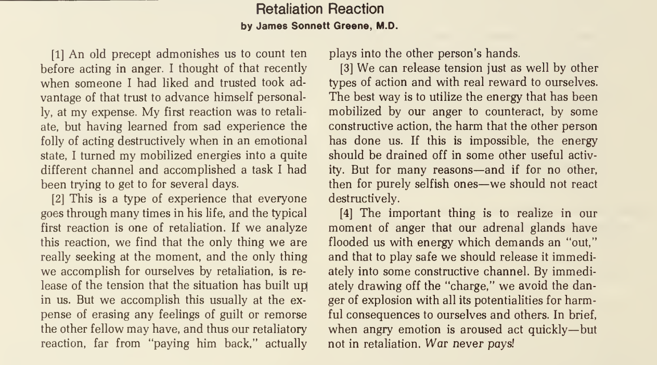
Notes:
Earlier passage
CLAIM - Human needs should be met without destroying the ecological systems on which those needs depend.
REASON - Forests provide essential ecological and economic benefits.
EXAMPLES / EVIDENCE - Forests regulate water, protect soil, store carbon, provide habitats, and support livelihoods.
EXPLANATION - If forests are destroyed, the resulting ecological damage can eventually undermine the very human needs that economic development is supposed to satisfy.

Slide 35
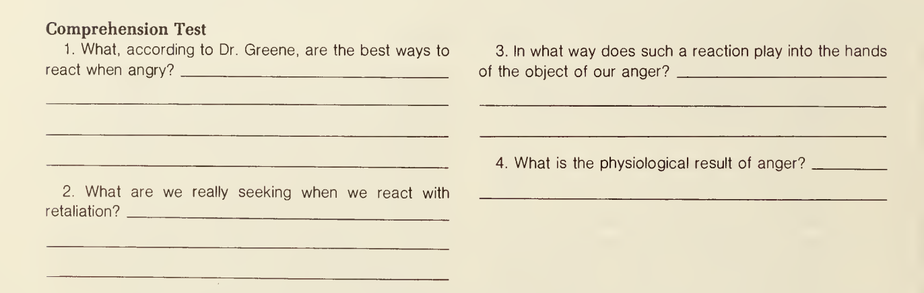
Notes:
1. By counteracting damage through constructive action, or by engaging in some useful activity.
2. Release of the tension (or draining off of the excess energy) produced by anger.
3. Relieves his guilt or remorse.
4. Flooding of the body with energy by the adrenal glands.
DISCUSSION
After some introductory material, Dr. Greene foreshadows his main point toward the end of paragraph 1, expresses it completely in paragraph 3, and pounds it home again in the final paragraph. The three important details queried in the test (what we seek when we retaliate, how retaliation affects the other person, and what anger does to our physiology) all explain the reasoning behind the author’s central thought.

Slide 36
Universities should encourage students to walk between classes whenever possible. Walking provides students with a simple way to remain physically active during a busy academic day. For example, a student who walks across campus several times a day may accumulate a considerable amount of physical activity without setting aside a separate hour for exercise. This matters because students often say that they do not have enough time for exercise. Walking therefore turns an unavoidable part of university life—moving from one classroom to another—into an opportunity for physical activity.
Notes:
CLAIM → What is the writer saying?
REASON → Why does the writer believe it?
EXAMPLE → What illustrates the point?
EXPLANATION → How does the example support the claim?
Students identify:
Claim: Universities should encourage students to walk.
Reason: Walking provides physical activity during a busy day.
Example: Students accumulate activity while moving around campus.
Explanation: Walking uses an activity students already have to do.

Slide 37
1.
Universities should encourage students to participate in extracurricular activities. These activities help students develop skills that cannot always be learned in the classroom. For example, students who participate in clubs often learn how to work with people who have different opinions and personalities. These experiences develop communication, teamwork and leadership skills, which can be valuable in professional life.
2.
Many students use their phones while studying. They check messages, watch short videos and respond to social media notifications. For example, a student may intend to check one message but end up spending twenty minutes scrolling through social media. These interruptions break concentration and make it harder to return to the original task. Students should therefore keep their phones away when they need to concentrate on important academic work.
Notes:
Claim?
Fact - Claim that asserts some empirical truth. Careful observation
Children are common victims of bullying on social media
Judgement of some sort – claim-based preferences or likes or dislikes
Washing hands is the better way to keep ourselves healthy
Drug abuse is not an option if you have problems
Claim of action
An action should be taken

Slide 38
Rahul reached the railway station at 7:15 in the morning. The platform was already crowded, and several passengers were waiting near the entrance. He bought a cup of tea and checked the electronic display. His train was delayed by twenty minutes. He called his friend, who was waiting for him at the other end of the city, and told him about the delay. A few minutes later, Rahul found a seat on a bench and opened his book.

Slide 39
Rahul reached the railway station at 7:15 in the morning. The platform was already crowded, and several passengers were waiting near the entrance. Public transport can be stressful when passengers have no reliable information about delays. Rahul checked the electronic display and discovered that his train was delayed by twenty minutes. He called his friend and explained the situation. The lack of clear information had already caused confusion about when he would arrive.
************************************************************

Slide 40
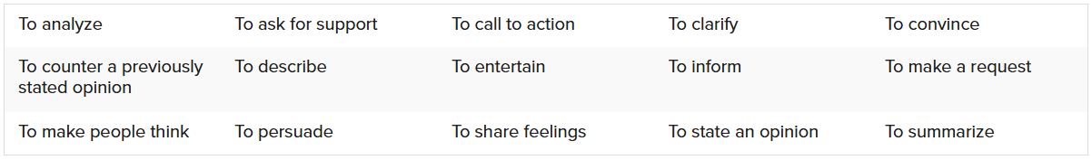
Audience
Might you have more than one audience?
What is most important to them?
What do you want your audience to think, learn, or assume about you?
Purpose
Notes:
To Inform: To teach, explain, or give facts (e.g., textbooks, news reports, recipes).
To Persuade: To convince the reader to believe something or take action (e.g., advertisements, opinion articles).
To Entertain: To amuse or tell an engaging story (e.g., novels, poems, humorous blogs)

Slide 41
Campus Cafeteria Notice
From Monday, the university cafeteria will introduce a reusable-container system. Students purchasing takeaway meals will receive their food in reusable containers and will be required to return the containers to designated collection points. A refundable deposit will be charged at the time of purchase. The system is expected to reduce the amount of disposable packaging generated on campus. Students are requested to return containers within 48 hours so that they can be cleaned and used again.
Questions
Who is the likely audience?
Who is not the primary audience?
What is the writer trying to achieve?
Is the purpose primarily: inform? persuade? criticize? warn? entertain?
Which words reveal the purpose?

Slide 42
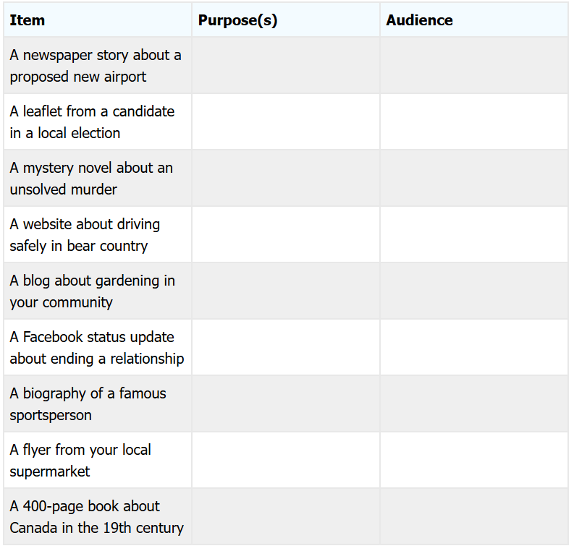

Slide 43
A) cause and effect
B) compare/contrast.
C) example.
D) definition.
E) sequential.
word choice: note the powerful words -- what connotations or feelings are evoked by the use of certain words?
word placement: what words introduce or conclude the idea discussed?
emphasis: what points are emphasized? are words repeated? which sentences are more heavily weighted?
organization: what organizational structure is used? how does the structure affect the idea being discussed?

Slide 44
The Romantic Period in literature resulted from the reaction to eighteenth-century rationalism in which writers tried to order their experiences with the world. During the eighteenth century the emphasis was on logical conclusions and reason as shown in the study of physics and mathematics and reflected in the literature of the time. The Romantics, on the other hand, turned away from these abstractions in favor of feelings and immediate experiences. They turned their backs on the idea of people as cold, rational beings and portrayed them in all their complexity, warmth, and diversity as individuals.
Individualism was stressed by Romantic authors and poets. The individual was valued, not looked down on, even though he or she was of peasant stock. In fact, many people in the upper classes went out into the countrysides to converse with those of "rustic and humble life." Literature became concerned with everyday life, not just the lives of kings and queens. Scenes of the family in a simple cottage and hearth, of shepherds and their flocks, and of labourers and their children working in factories were commonplace in Romantic literature. Their feelings, memories, and imaginations suddenly seemed more real and important than those in more opulent surroundings.
Notes:
Cause signals
because
since
owing to
due to
as
because of
stems from
results from
is caused by
Effect signals
therefore
thus
hence
consequently
as a result
so
leads to
results in
causes
produces
contributes t

Slide 45
1. the author's purpose is –
A) to describe the Romantic Period.
B) to contrast the Romantic Period with the literature of the eighteenth century.
C) to analyze literature of the Romantic Period.
D) to define just what the Romantic Period involved.
2. In developing the second paragraph, the organizational pattern used by the author could be described as –
A) cause and effect. The first sentence states a cause and the remaining sentences of the paragraph are effects.
B) simple listing. The first sentence states the basis for listing other information as remaining sentences of the paragraph.
C) example. The first sentence is followed by a number of examples used to illustrate it.
D) definition. The first sentence provides a definition and the remaining sentences of the paragraph explain it.
Notes:
C C

Slide 46
In recent decades, urban sociologists have studied the phenomenon of “cultural districts”—neighborhoods defined by a concentration of artistic venues, workshops, and galleries. Initially dismissed by some critics as gentrification agents, these districts have gradually gained recognition for their role in urban revitalization and community cohesion. Cultural districts often emerge organically, sparked by a small group of artists seeking affordable studio space. Over time, these areas become vibrant economic ecosystems where craft makers, performance spaces, and art schools thrive. Rather than displacing long-term residents, cultural districts may support them by creating employment opportunities and attracting local investment. Furthermore, their presence can transform public perception of a neighborhood, turning it from a neglected zone into a celebrated urban landmark. However, skeptics remain. Some fear that cultural districts commodify local art, cater primarily to tourists, and fail to address root social problems like poverty. A successful cultural district, proponents argue, requires careful planning and sustained effort to balance growth, authenticity, and inclusivity. In doing so, a district can foster neighborhood identity, encourage cultural exchange, and even spur civic pride, ultimately benefiting both local residents and the broader city.

Slide 47
1. The primary purpose of the passage is to:
(A) Critique cultural districts for harming local communities.
(B) Describe the emergence and potential value of cultural districts.
(C) Compare cultural districts to traditional art museums.
(D) Show that cultural districts rarely succeed economically.
(E) Argue that cultural districts cause gentrification.
2. The passage’s overall organization is best described as:
(A) Presenting a historical timeline of cultural districts.
(B) Introducing a concept, acknowledging objections, and suggesting a balanced view.
(C) Listing only the benefits of cultural districts.
(D) Offering a single counterexample to a prevailing theory.
(E) Proposing a policy solution without discussing drawbacks.
Notes:
B B

Slide 48
Contemporary debates in bioethics often pivot around the tension between individual autonomy and the collective good. In medical resource allocation, for instance, a purely individualistic approach might prioritize patient choice above all else, potentially resulting in inefficient use of limited supplies. Conversely, a strictly utilitarian approach could maximize overall benefit while sacrificing personal freedom. Many ethicists advocate for a balanced framework—one that respects individual rights but also considers broader social impacts. This might mean setting guidelines that ensure fair access to treatments, transparent decision-making, and ethical review boards capable of navigating morally fraught scenarios. Such frameworks are continuously evolving, shaped by advances in medical technology, shifting cultural values, and ongoing discourse among healthcare professionals, policymakers, and the public. Achieving the right equilibrium is an ongoing challenge, illustrating the complexity inherent in applying moral theories to real-world health dilemmas.

Slide 49
The passage’s main theme is:
(A) The complexity of balancing personal autonomy and societal
welfare in bioethics.
(B) The superiority of a purely individualistic approach.
(C) The need to eliminate ethical review boards.
(D) The irrelevance of utilitarian principles.
(E) The simplicity of moral decision-making in healthcare.
****************************************************************
Notes:
Author's attitude: Analytical and balanced
Author's purpose: To inform/explain
Tone: Academic, measured, cautious

Slide 50
Assumption
The Ground was slippery, it must have been raining.
Conclusion? Premise?
Assumption?
The ground was slippery. The ground cannot have become slippery without rains. So, it must have rained.
Notes:
The ground becomes slippery only when it rains

Slide 51
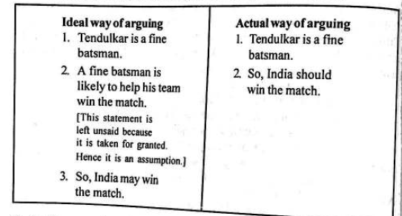

Slide 52
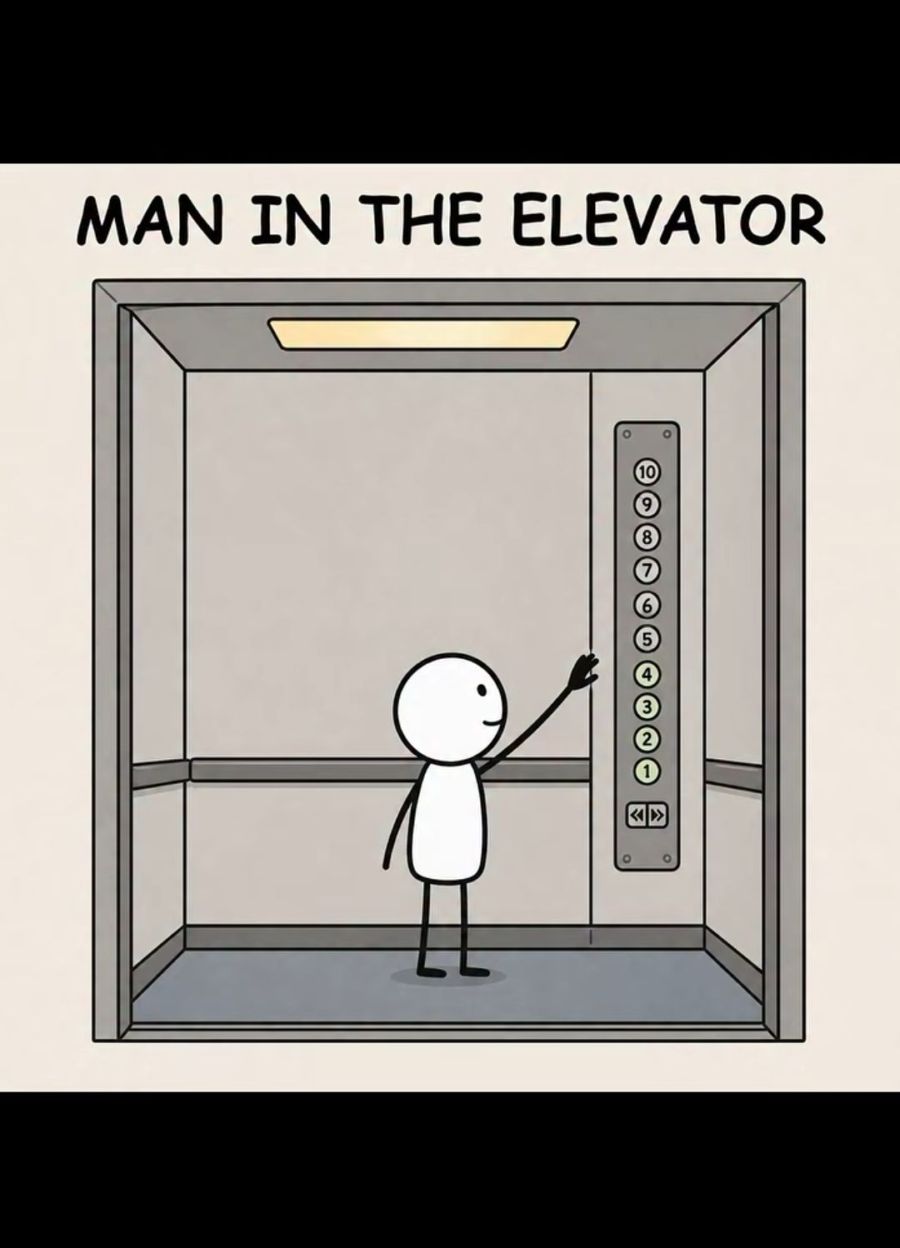
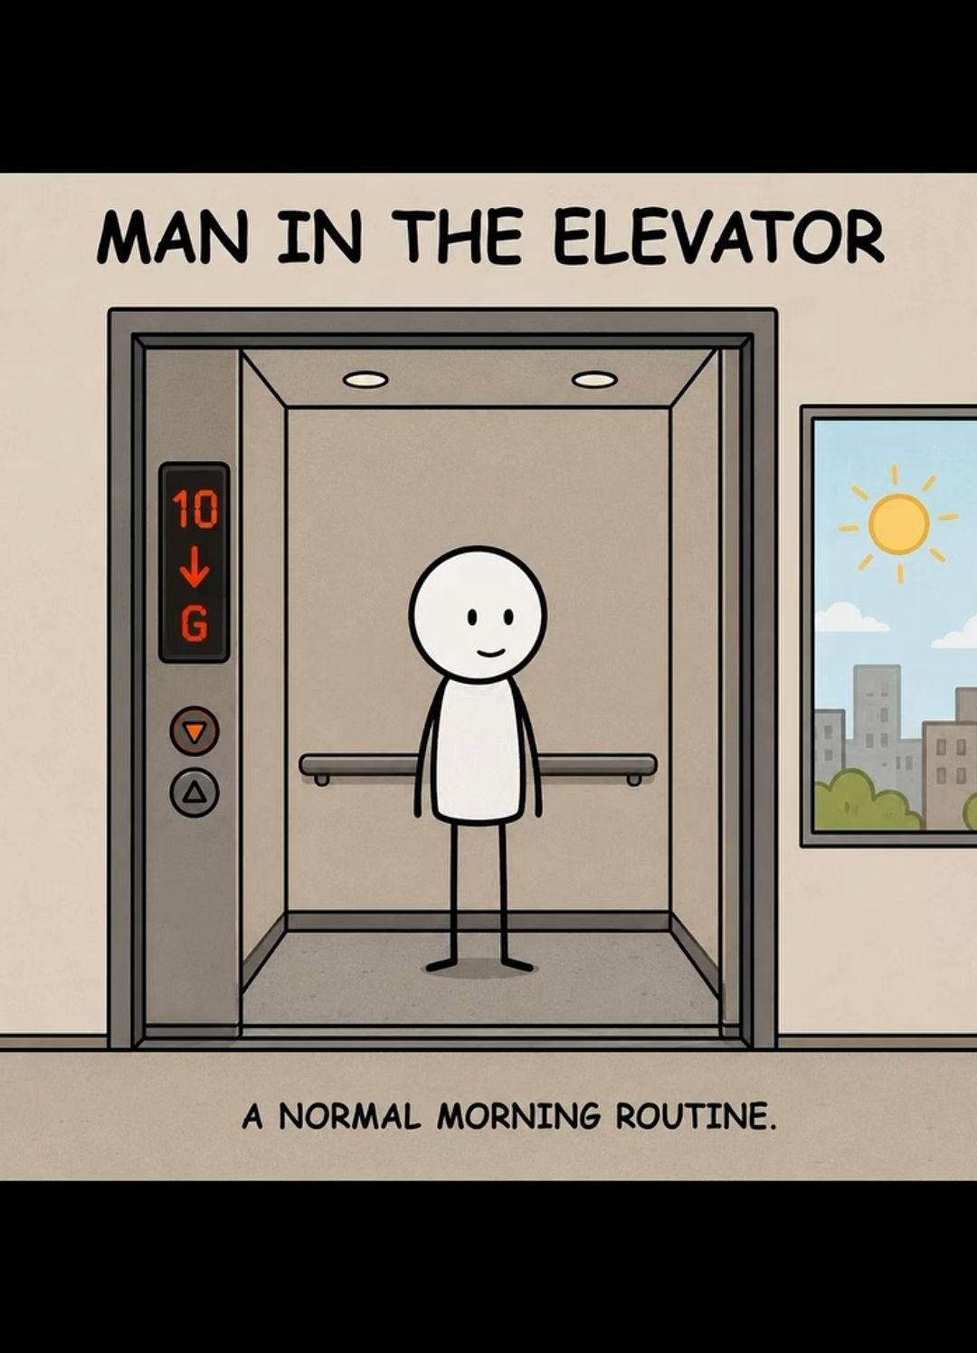
If Sudha eats rice, Ram also eats rice. If Ram eats rice, Shyam also eats rice. If Shyam eats rice. Manju also eat rice. If Manju eats rice, Madan also eats rice.
Notes:
A man lives on the 10th floor of a building. Every morning, he takes the elevator from the 10th floor to the ground floor and goes to work.
When he returns in the evening, he takes the elevator up to the 7th floor and then walks up the stairs to the 10th floor.
However, when it is raining, he takes the elevator directly to the 10th floor.
Why?

Slide 53
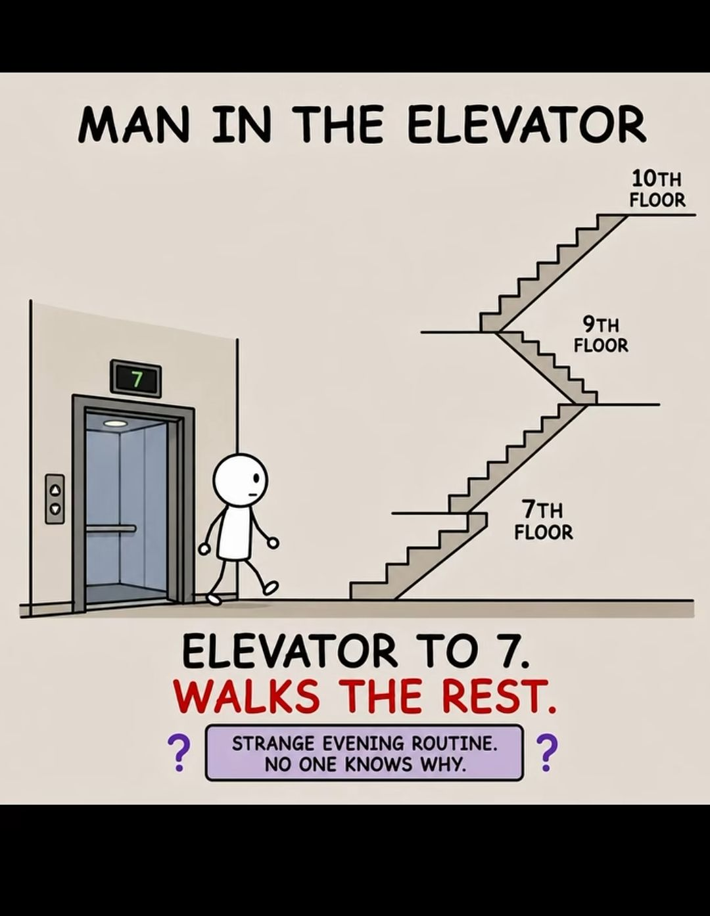
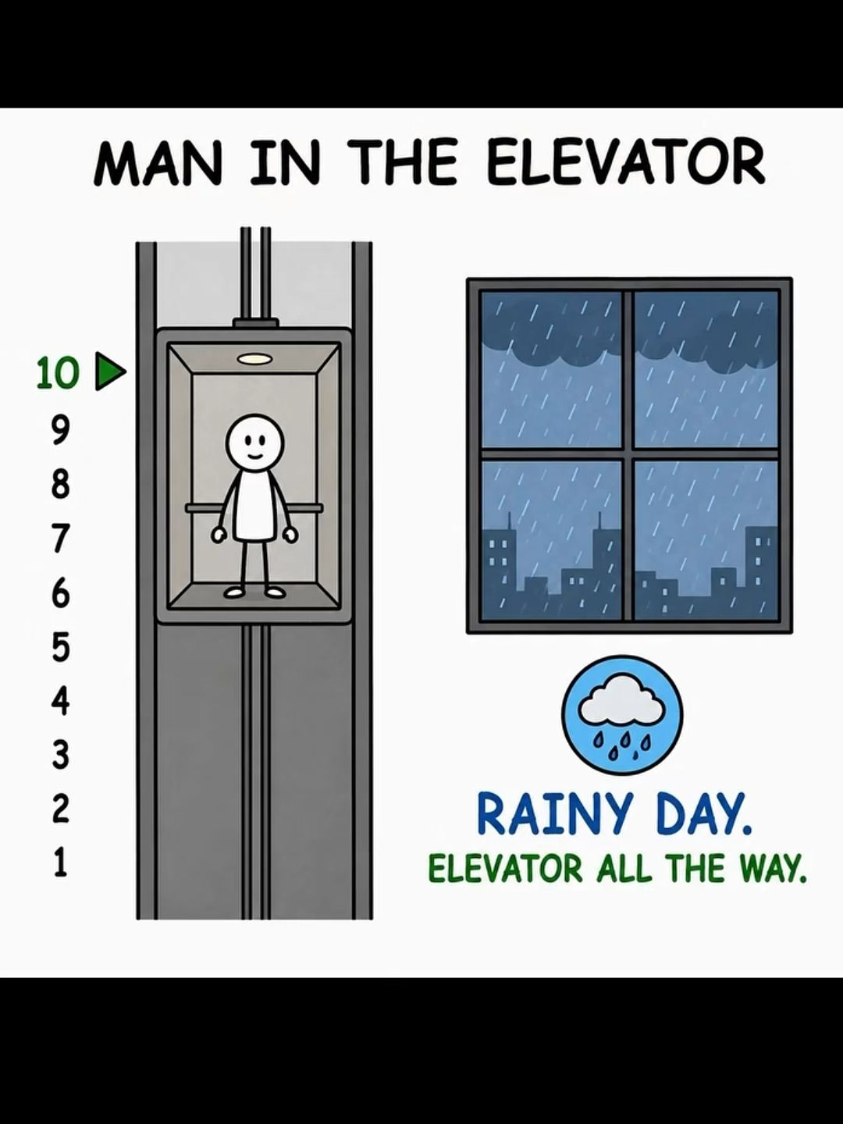
Notes:
Assumption
Valid / Invalid
Why?
The man lives on the 10th floor. Valid Explicitly stated. Strictly speaking, this is a fact, not an assumption.
The man works somewhere outside the building. Reasonable/valid inference He goes to work after leaving the building, although the exact workplace is not stated.
The man is physically capable of walking up stairs. Reasonable assumption He walks from the 7th to the 10th floor.
The man is short. Valid inference It explains why he cannot press the 10th-floor button but can press the 7th.
The elevator is working normally. Reasonable assumption He regularly uses it to travel between floors.
The man is afraid of elevators. Invalid Nothing in the passage suggests fear.
The man is lazy. Invalid There is no evidence for this.
The elevator is broken between the 7th and 10th floors. InvalidIf this were true, the rain would not explain the change in behaviour.
The man deliberately chooses to exercise by climbing three floors. InvalidThere is no evidence that exercise is his motivation.
The umbrella helps him reach the 10th-floor button. Valid inferenceThis is the key explanation supported by the clues.
The man is unable to walk beyond the 7th floor. Invalid He actually walks from the 7th to the 10th floor.
It rains every day. Invalid The passage only says when it is raining.
The man owns an umbrella. Valid inferenceThe explanation requires him to have an umbrella on rainy days.

Slide 54
Statement: It is desirable to put the child in school at the age of 5 or so.
Assumptions:
At that age the child reaches appropriate level of development and is ready to learn.
The schools do not admit children after six years of age.

Slide 55
Definitive words
Statement: The BoP crisis has worsened and the government should make every effort to boost exports
Assumption 1 : Exports are the best solution to avert the BoP crisis.
Assumption 2: Exports are a reasonably good solution to the BoP crisis.
Assumption 3: Exports are the only solution to overcome the BoP Crisis.
Assumption 4: The BoP crisis will definitely be averted by boosting exports.
Assumption 5: The BoP Crisis will probably be averted by boosting exports.
Valid ?
Notes:
II and IV valid
Earlier passage
Human beings have the ability to manage natural resources more responsibly. valid
Technological development will automatically solve the problem of deforestation. Invalid
Economic growth should be pursued regardless of environmental consequences. Invalid
Economic development is important to human societies. valid

Slide 56
Example
"I am not going to call off the strike unless the government announces free education to every child in the area. Education is a basic right of every child and it is impossible for me to keep a blind eye when this right is being violated." - X, a political leader.
What is stated?
Education is a basic right.
This right is being violated.
The leader will continue the strike.
Assumption ?
Notes:
You might infer: X strongly believes the government is responsible for addressing the lack of education.
Assumption → Something the statement depends on
Implication → Something that can be derived from the statement
Implication — What follows from the statement?
→ Many children are not receiving education.
Assumption - Continuing the strike may pressure the government to accept the demand.

Slide 57
Description = What?
What does the text say?
Main idea
Examination = How?
What is the claim?
What reasons are given?
What evidence/examples are provided?
Is there a connection between the reason and the claim?
What assumptions does the writer make?
What is missing?
Evaluation = How well?
Is the evidence sufficient?
Is the evidence relevant?
Is the reasoning logical?
Is the assumption reasonable?
Is important information missing?
Is there another explanation?
Judgment = So what?
I like the writer's opinion= No
Based on the strength and limitations of the argument, what conclusion can I reasonably reach?
Notes:
Think aloud:
"First, I am only describing. I am not judging."
Then:
"Now I'm examining. What reasons has the writer used?"
Then:
"Now I'm evaluating. Is that evidence sufficient?"
Finally:
"Now I'm making a judgment."

Slide 58
Inference
Inference is a conclusion that the reader reaches by combining information from the text with reasoning.
Inference = What the text does not directly say, but gives you enough evidence to figure out.
“Rohan entered the classroom carrying a wet umbrella. His shoes were covered with mud.”
It was probably raining?
Notes:
An inference is an evidence-based conclusion, not a guess.
Inference = What can I reasonably conclude from the evidence?
Implication = What does the text suggest without saying directly?
Assumption = What must the writer believe/take for granted for the argument to work

Slide 59
In the forties, nationalisation was considered the panacea for all socio-economic ills. Today, privatisation has become the buzzword that has been sweeping both the developed and the developing world for more than a decade now. Even in India, the idea has been gathering momentum. But, before the idea is transplanted in India, there are several aspects of privatisation that need to be understood. It would be worth while, in this context, to look at the experiences of other countries.
Inference: India is also thinking of privatization?
Notes:
Privatisation is gaining support in India- valid
India has decided to privatise. – invalid
India should privatise. - invalid

Slide 60
When the college announced that classes would begin at 8 a.m. instead of 9 a.m., many students immediately started discussing the change in the WhatsApp group. Some students complained that they would have to leave home before sunrise, while others said that public transport would be difficult to find at that hour. A few students, however, welcomed the decision because they believed finishing classes earlier would give them more time in the evening.
The students have mixed reactions to the change.
Some students travel relatively long distances or depend on public transport.
Some students welcome it.

Slide 61
Sally overslept. Therefore, she did not eat breakfast. She realized that she was late for school, so she ran as fast as she could and did not see a hole in the ground which was in her path. She tripped and broke her ankle. She was then taken to the hospital and while lying in bed was visited by her friend, who wanted to know why she had got up so late.
Which of the following conclusions can be made from the above passage?
A) Because Sally did not eat her breakfast, she broke her ankle.
B) Sally's friend visited her in the hospital because she wanted to know why she was late for school.
C) Sally did not notice the hole because she overslept.
D) Sally broke her ankle because she went to bed late the previous night.
E) Sally's broken ankle meant she did not go to school that day.
Notes:
Here, we have a chain of events when the conclusion of one argument becomes the premise for another.
Only (C) can be concluded from the facts given in the passage - that is, because Sally overslept, she ran towards school, and because she ran, she did not notice the hole.
Choice (A) is inappropriate because the chain of events is not linked by the fact that Sally did not eat her breakfast. The passage does not include a consequence emanating from that fact.
Choice (B) is not appropriate because there is no way to link Sally's friend to the events in the passage.
Similarly, facts not included preclude (D) from being the appropriate answer.
Finally, (E) cannot be inferred, as we do not know what Sally did later that day; she may have been released from the hospital and gone to school.

Slide 62
Artificial intelligence (AI) tools are becoming increasingly common in universities. Students can use them to explain difficult concepts, generate ideas, summarize readings, identify weaknesses in an argument, and receive feedback on their writing. For students who need additional support, these tools can make learning more accessible and efficient. It is therefore tempting to view AI as simply another educational resource, similar to a textbook or search engine.
Yet greater efficiency does not necessarily produce greater learning. A student who uses AI to understand a difficult theory may become more confident and then explore the subject independently. Another student may copy an AI-generated explanation into an assignment without understanding it. If students regularly ask AI to generate arguments, organize their thoughts, or rewrite their sentences, they may also have fewer opportunities to develop these abilities themselves. Moreover, AI systems can provide inaccurate information while presenting it with considerable confidence. Students who fail to verify such information may reproduce errors without recognizing them.
These concerns do not necessarily mean that universities should prohibit AI. Instead, universities could require students to disclose their use of AI and explain how they evaluated or modified its output. Such a policy would allow students to benefit from technology while maintaining responsibility for their own work. The effectiveness of this approach, however, would depend on whether students are actually taught how to question, verify, and critically evaluate AI-generated information rather than simply being instructed to report its use.

Slide 63
Verbal ability and language refinement
the skill to understand, use, and reason with language effectively.

Slide 64
Vocabulary — Do I know the right words?
Understanding meanings, synonyms, antonyms, word usage, and choosing precise words.
The manager approved the proposal.
The manager accepted the proposal.
2. Grammar — Can I construct sentences correctly?
❌ She don't understand the problem.
✅ She doesn't understand the problem.
3. Expression — Can I communicate my thought clearly?
❌ The meeting was kind of bad because many things happened.
✅ The meeting was ineffective because the discussion lacked clear objectives.
So, verbal ability is not simply “speaking good English.”
Understand language + Use language + Analyze language + Express ideas

Slide 65
Vocabulary Building
    Synonyms and antonyms
    One-word substitutions
    Idioms and phrases
    Phrasal verbs
    Commonly confused words
    Homophones/homonyms
    Word roots, prefixes, and suffixes
    Contextual vocabulary
    Collocations
Notes:
Difficult – challenging – hard – tough – onerous – demanding- punishing – back breaking
Burdensome – arduous – strenuous – taxing – laborious
One who loves books Bibliophile
One who cannot read or write Illiterate
A person who speaks many languages Polyglot
Break the ice
Once in a blue moon
Hit the nail on the head

Slide 66
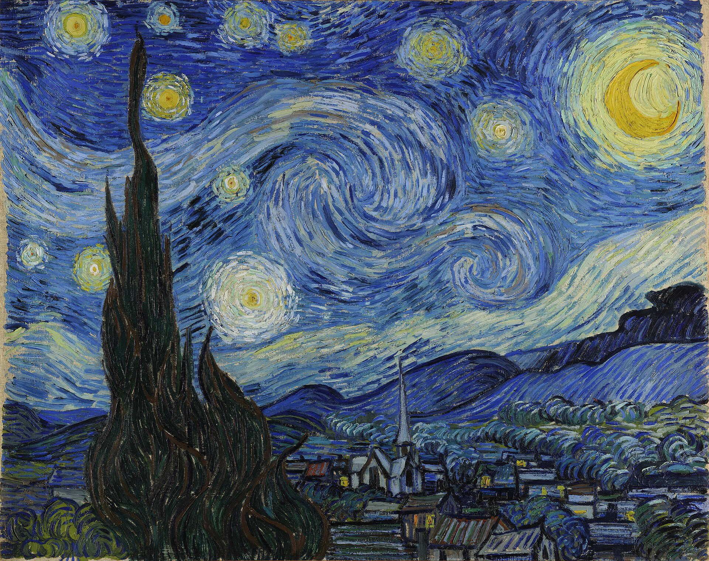

Slide 67
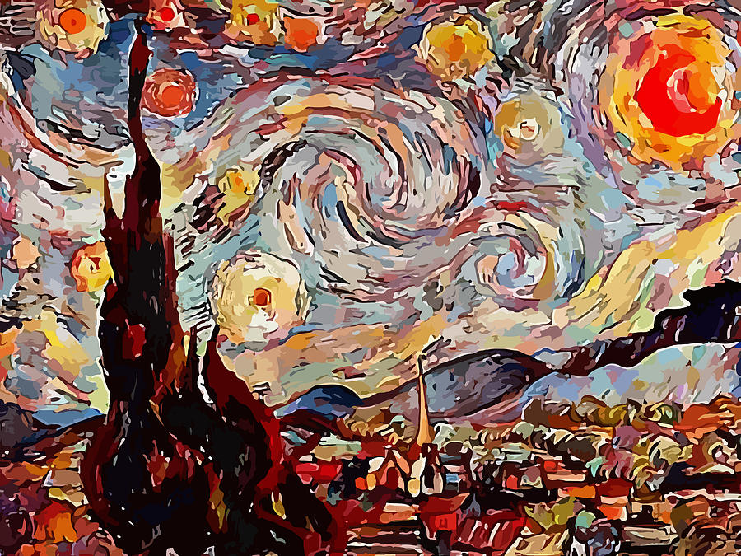

Slide 68
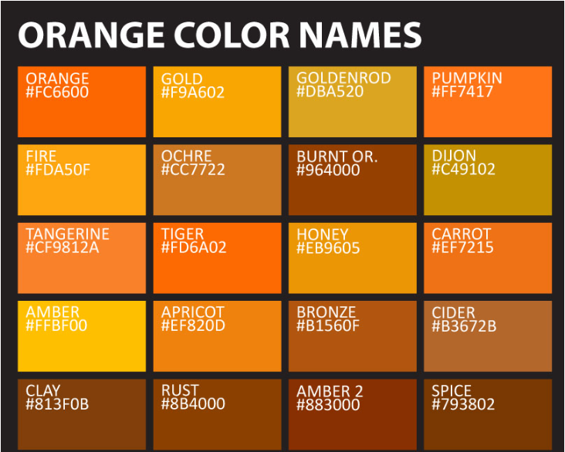

Slide 69
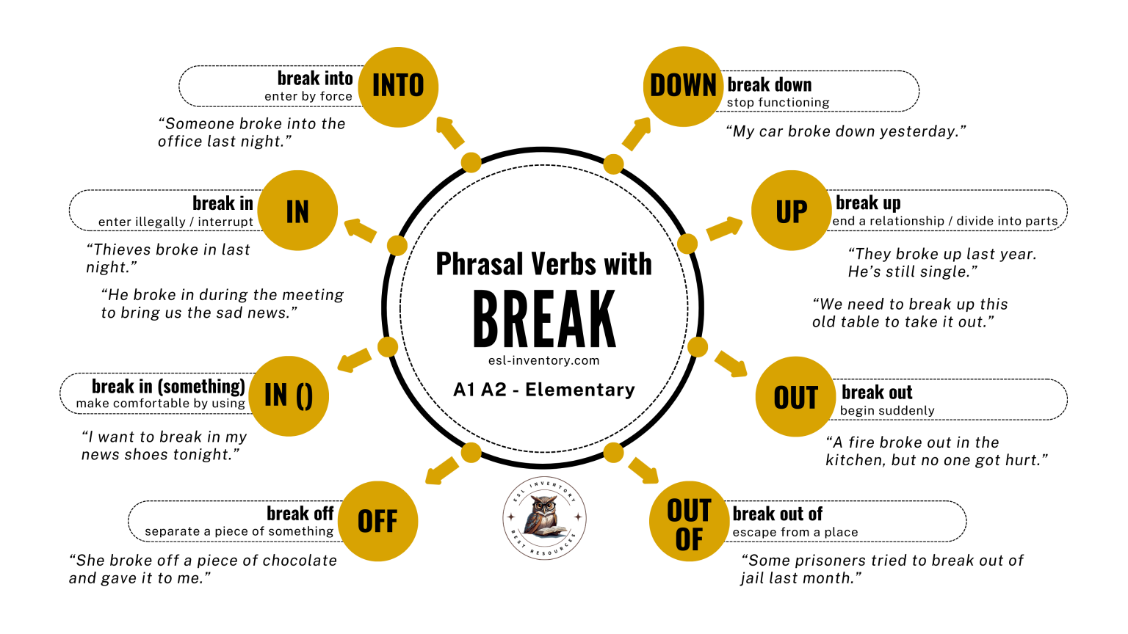

Slide 70
Accept vs. Except
      Accept = receive/agrees to something
      She accepted the offer.
      Except = excluding
      Everyone came except Rahul.
Affect vs. Effect
    Affect = influence
    Lack of sleep can affect your concentration.
    Effect = result
    The medicine had a positive effect.
Compliment vs. Complement
    Compliment = praise
    She complimented him on his presentation.
    Complement = complete/enhance
    The shoes complement her dress.
Notes:
Homophones / Homonyms
Words that sound alike but have different meanings/spellings.
There / Their / They're
There = place → Put the books there.
Their = belonging to them → Their house is large.
They're = they are → They're coming soon.
Principle / Principal
Root: bio = life
Biology → study of life
Biography → story of someone's life
Biodiversity → variety of life
Prefix: anti- = against
Antisocial
Antibacterial
Antithesis
Suffix: -less = without
Careless = without care
Fearless = without fear
Homeless = without a home

Slide 71
very angry | furious, enraged
very happy | ecstatic, delighted
very sad | devastated, miserable
very scared | terrified, petrified
very tired | exhausted, drained
very hungry | starving, famished
very thirsty | parched, dehydrated
very cold | freezing, frigid
very hot | scorching, sweltering
very surprised → astonished
very worried → anxious
very careful → meticulous
very messy → chaotic
very busy → swamped
very confused → bewildered
very strong → powerful
very weak → feeble
very bright → dazzling
very dark → pitch-black
Notes:
Collocations
Words that naturally occur together.
make a decision ✅
do homework ✅
heavy rain ✅
strong coffee ✅
commit a crime ✅
take responsibility ✅

Slide 72
(A) There were / (B) no less than fifty persons / (C) present in the room / (D) No error
2. (A) Few remarks / (B) that he made were / (C) offensive to my friend / (D) No error
3. Before the alarm had stopped (A)/ ringing (B)/ Nisha had telephoned (C)/ the police (D)/ No error (E).
4. The teacher of English(A)/ gave him a home work (B)/ to complete that (C)/ by night positively(D)/ No error (E).
5. The board of directors (A)/ want the facilities (B)/ of car and accommodation (C)/ for itself (D)/ No error (E).
6. Every teacher (A)/ for this school is determined to do their best (B)/ for the benefit of all (C)/ No error (D).
7. The officer(A)/ as well as the (B)/ clerks absented themselves(C)/ from the office (D)/ No error (E).
8. Can we rely (A)/on this agency (B)/for the last news (C)/of the day (D)/ No error (E).
Notes:
Replace "less than" by "fewer than“
Add "a" before "few"
Using "a few" instead of "few" in a sentence changes a sentence's meaning. Whereas "a few" implies a small number of some that is greater than two, "few" implies only a small number. Other words, like "very" or "quite," may also come before "a few" or "few" and further change sentence meaning. Examples can be found below
Delete 'had'. In past perfect tense, simple past is used for the work completed later.
delete 'a' before home work. Home work is an uncountable noun.
Replace 'itself' by 'themselves'. Here, Board of Director is not used as a collective noun, that is why plural verb 'want' (not 'wants') is used.
Replace 'their' by 'his'. Singular pronoun is used when two singular nouns are preceded by each/every.
7. Replace 'themselves' by 'him'. When two nouns are joined together with as well as/ besides/ in addition to, the pronoun is governed by the noun that comes first.
8. Replace 'last' by 'latest'.

Slide 73
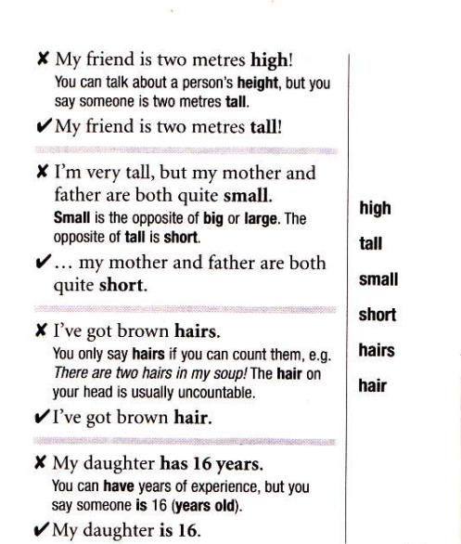
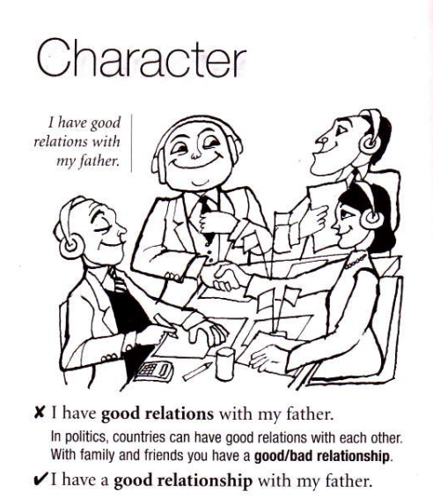

Slide 74
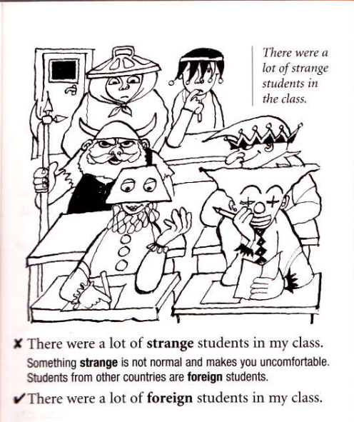
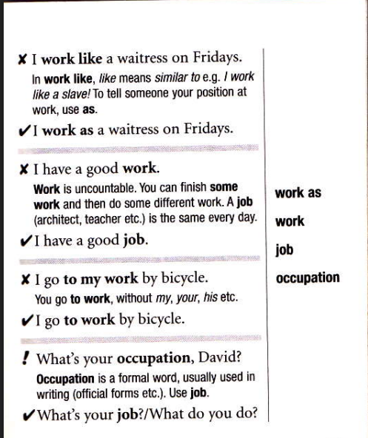
Notes:
Uncle has gone doolally again after watching the news all morning

Slide 75
1. According to me, .. / As per me, ...
Correct:
  In my opinion,
  I think, ...
The phrase "According to" or "As per" is used to refer to a third person (someone who isn't you), who is often an expert on the subject. For example, "According to Newton, there are three laws of motion." If you say 'According to me', then you are citing yourself as an expert (and you probably aren't an expert).
2. Students must cope up with stress.
Correct: Students must cope with stress. The preposition "up" here is not necessary. To cope up is not a phrasal verb.
3. Although I was hungry, but I didn't stop studying.
Correct:
    Although I was hungry, I didn't stop studying.
    I was hungry, but I didn't stop studying.
The words although and but have the same function. You should only use one of these words in a sentence to present contrasting ideas, not both of them.

Slide 76
  Subject-verb agreement
She go to college every day.
He play cricket
✖ The results of the experiment shows significant improvement.
The list of items are on the table
The quality of these products are poor
  Redundant phrasing and wordiness
In the event that the experiment fails, we will repeat it again.
In my personal opinion
Due to the fact that – because
I have told you again and again
Redundancy = using a word or phrase whose meaning is already contained in another word or phrase, without adding useful meaning.
Notes:
He shows
They Show
List = is
Quality = is
The subject is result and not the experiment
The student works hard
The students work hard
Free gift Gift
Past history History
Future plans Plans
Basic fundamentals Fundamentals
Final conclusion Conclusion
Redundant Tense & Helping Verbs
Incorrect: I did not saw him. -> Correct: I did not see him. (Always use the base verb after “did”).
Incorrect: We have reached yesterday. -> Correct: We reached yesterday. (Don’t use “have” with a specific past time).
Incorrect: He has been working here since 10 years. -> Correct: He has been working here for 10 years. (Use “for” for duration).

Slide 77
Improper use of prepositions
✖ The results were consistent to previous studies.
✔ The results were consistent with previous studies.
“I’m in the restaurant” when you mean, “I’m at the restaurant.”
He is good in mathematics.
She is senior than me.
I and Me
They’re nothing like Billy and me.
She chose Lily and me
Lily and I went to the store
He has little money.
He has a little money
I spent the little money I had
Notes:
Use ‘at’ when you’re talking about specific locations, like “at the office” or “at the park.” Use ‘in’ when you’re referring to something more general or enclosed, like “in the city” or “in the car.”
PLACE TIME
IN large/enclosed area long period
ON surface day/date
AT exact point exact time
Little almost none negative
a little some, though not much positive/neutral
the little the small amount that exists specific

Slide 78
Improper use of Articles
I am going to the Mumbai. | I am going to Mumbai. | Never use “the” before names of cities or people.
It is an unique opportunity. | It is a unique opportunity. | Though it starts with ‘U’, the sound is ‘Yoo’ (consonant sound), so use “a”.
He is a honest man. | He is an honest man. | ‘H’ is silent; the word begins with a vowel sound.
We need to buy a furniture. | We need to buy furniture. | Furniture is uncountable; you cannot use “a” before it.
She is best girl in class. | She is the best girl in class. | Always use “the” with superlative adjectives (best, tallest, highest).
Notes:
Open word file

Slide 79
Question formation
Incorrect: You are coming tomorrow? -> Correct: Are you coming tomorrow?
Incorrect: Why you are late? -> Correct: Why are you late?
Incorrect: Where I can find a taxi? -> Correct: Where can I find a taxi?
Incorrect: What he is doing? -> Correct: What is he doing?
The “Only” Obsession
Incorrect: I live here only. -> Correct: I live right here.
Incorrect: I will do it today only. -> Correct: I will do it today.
Incorrect: That only I was saying! -> Correct: That is exactly what I was saying.

Slide 80
Error: "I will take all the books accept this one."
Correction: "I will take all the books except this one."
"Out of station" (to be out of town or away from home) - Indian English
Correction: "Out of town" or "away from home" - Standard English
"Do the needful" (a phrase used to request someone to do what is necessary) - Indian English
Correction: "Please do what is necessary" or "Please take care of it" - Standard English
"Preferential voting" (to vote for a candidate in a specific order of preference) - Indian English
Correction: "Ranked voting" - Standard English
"Pass out" (used to mean "graduate") - Indian English
Correction: "Graduate" - Standard English
"One minute, I will come" (used to mean "Wait a moment, I will come") - Indian English
Correction: "Wait a moment, I will come" - Standard English
Notes:
In India, people say passed out of college meaning graduated
In global English, passed out means faint, collapse
I’ll “prepone” the meeting. I’ll bring the meeting forward

Slide 81
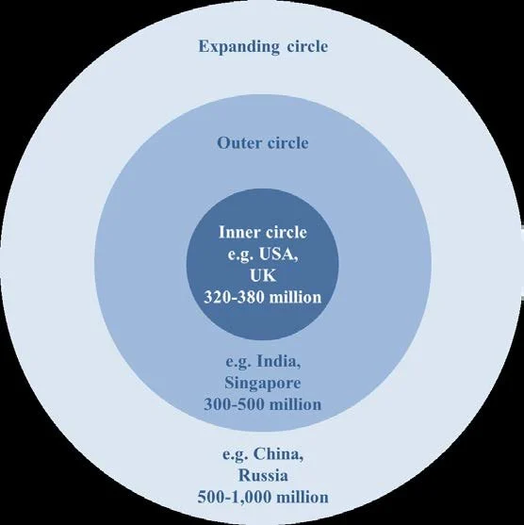
https://youtu.be/HyqSi6zNKKs
Notes:
Norm providing developing and dependent
ENL ESL EFL

Slide 82
Please do the needful. | Please take the necessary action.
Revert back to me. | Please get back to me.
I will revert. | I will get back to you.
Kindly do one thing. | Could you please…?
Discuss about the issue. | Discuss the issue.
Order for two laptops. | Order two laptops.
Passed out from college. | Graduated from college.
Myself Rahul. | I am Rahul. / My name is Rahul.
I am having two years of experience. | I have two years of experience.
I am working here since 2023. | I have been working here since 2023.
What is your good name? | What is your name?
Where do you stay? | Where do you live?
I have a doubt. | I have a question.
Today morning | This morning
Today itself | Today / By the end of today

Slide 83
Interpersonal communication:
□ Active listening
□ Feedback
• Empathy

Slide 84
Interpersonal Communication
Communication between two or more people in which they interact with and respond to one another.
face-to-face communication in organizations
How much time one spents in conversation, meetings and discussion?
How effective is this major investment in time and energy?
Notes:
organizations which failed to recognize or value these skills in their employees would simply not generate the trust, co-operation and creativity which are needed for long-term success.
people spend almost 45 per cent of their working time in listening.
respond or react to the other person or persons in ways which appear ‘natural’ and which are ‘effective
non-verbal communication (NVC);
reinforcement;
questioning;
reflecting;
opening and closing;
explanation;
listening;
self-disclosure;
influencing;
assertiveness;
group interaction and leadership;
humour and laughter.

Slide 85
Active Listening
‘We have two ears and one mouth so that we can listen twice as much as we speak.’
–Epictetus
No communication process is complete without listening.
Listening is a process of receiving, interpreting, and reacting to a message received from the speaker.
Good listening involves encouraging the other person (the speaker in this case) by being sensitive to the thoughts and emotions hidden in their expressions. We also need to be patient while listening because otherwise we will lose track of what is being said.
People believe that a good speaker is essentially a good communicator, but this may not be always true.
Listening takes a lot of energy
Notes:
Active listening = listening to understand.
Passive listening = hearing without actively engaging with or processing the speaker's message.
If you observe a salesperson carefully, you will realize that he/she is successful not because of his/her persuasive power in speaking but because he/she has
listened to the customer’s need carefully, which has enabled him/her to sell his/her point well.
doctor

Slide 86
Listening training is unavailable
Speed of thought is more than speed of speech – Most of us speak at the rate of about 125 words per minute. However, we have the mental capacity to understand someone speaking at 400–500 words per minute.
We are inefficient listeners- Immediately after listening to a 10-minute oral presentation, the average listener has listeners heard, understood, and retained 50 per cent of what was said. Within 48 hours, that drops off by another 50 per cent, to a final level of 25 per cent efficiency.
We create unnecessary problems for others and ourselves: misunderstandings, hurt feelings, confused instructions, loss of important information, embarrassment, frustration, and lost opportunities.
Notes:
How Much are You Paid for Listening? A manager asked her secretary to keep track of the
time she spent listening on the telephone. She was shocked to discover that her company was paying
her 35 per cent of her salary, or $18,000, for this function.

Slide 87
Joe has prepared for a presentation for three days. When he presents, he forgets his points and the class laughs. After class, he says, “I think I'm just terrible at presentations.”
What would you say ?
“Don't worry, you'll do better next time.”
“You should practise more.”
“It's okay, everyone makes mistakes.”
“I know how you feel.”
“You shouldn't think negatively.”
Notes:
“All these responses are intended to help. But are they actually responding to what Rahul is feeling?”
“That must have been really embarrassing, especially after preparing for three days and then forgetting your points in front of everyone. I can understand why you feel terrible about it. But one difficult presentation doesn't mean you're terrible at presentations.”
Recognises the emotion: “That must have been really embarrassing.”
Acknowledges his perspective: “I can understand why you feel terrible about it.”
Doesn't immediately judge or give advice: It first shows understanding before trying to change his thinking.
❌ Advice: “Don't worry. Just practise more next time.”
❌ Dismissal: “It's not a big deal. Everyone makes mistakes.”
❌ Judgment: “You should have prepared better.”
❌ Forced positivity: “Come on, you're actually a great presenter!”

Slide 88
Sympathy
“I feel sorry for you.”
You recognise someone's difficulty, but remain somewhat outside their experience.
Empathy
“I try to understand what this feels like from your point of view.”
Friend:
“I didn't get selected for the cricket team.”
Sympathy:
“Oh, that's really sad. Don't worry.”
Empathy:
“You were really hoping to make the team. It must be disappointing after putting in so much effort.”
Give students the key distinction:
Sympathy = feeling for someone.
Empathy = trying to understand someone.

Slide 89
Perspective-taking
“If I were in this person's situation, what might I be thinking or feeling?”
A student comes to class without completing an assignment. The teacher asks why. The student says, “I couldn't finish it.”
We often see behaviour, but we don't automatically know the reason behind it.
“Empathy requires us to pause before making an assumption about another person's behaviour.”
Behaviour ≠ complete story
Notes:
He was lazy.
He forgot.
He didn't understand the assignment.
He was busy.
He had another problem.
He was struggling with the topic.

Slide 90
Recognising emotions
Give them a situation:
“I studied for the exam, but I still got 42 marks. I don't know what I'm doing wrong.”
What might the person be feeling?
Possible answers:
disappointed
frustrated
confused
anxious
discouraged
embarrassed
Then make an important distinction:
Don't say: “You are frustrated.”
Better: “You seem frustrated.”
Notes:
Pay attention to the speaker's emotions, not just words
Notice feelings that may be implied rather than explicitly stated
Respond with empathy
Be careful not to tell people what they should feel

Slide 91
“I gave my presentation today and completely messed it up.”
Response A: “It's not a big deal. You'll get over it.”
Response B: “You seem disappointed because you had prepared for it.”
Which is more empathetic? Why?
“Everyone in my group ignores my ideas.”
Response A:
“You should just speak louder.”
Response B:
“That sounds frustrating, especially if you feel that your ideas aren't being heard.”

Slide 92
Be Non-Evaluative
Listen without immediately judging
Separate the person from the idea
Avoid labels: “That’s stupid,” “You’re wrong,” “That makes no sense”
Communicate acceptance, not approval
Be tolerant even when you disagree
Understanding ≠ agreeing
Reflect Implications
Go beyond repeating the exact words
Identify what the speaker's idea might lead to
Encourage the speaker to develop their thinking
Use this to understand, not to show how clever you are

Slide 93
Invite Further Contributions
Ask questions when you need more information
Prefer open-ended questions
Encourage the speaker to explain further
Don't turn the conversation into an interrogation
Don't Take Over the Conversation
Keep your responses short and clear
Don't interrupt unnecessarily
Don't turn every story into your own story
Don't rush to give advice
Give the speaker space to finish
If you are doing most of the talking, you may not be listening.

Slide 94
Feedback
Judgment and advice
“Why might ‘You should practise more’ be a poor first response?”
STOP — Don't immediately judge.
UNDERSTAND — What might this person be feeling?
RESPOND — Acknowledge the feeling before giving advice.
Immediate judgment - “You should have prepared better.”
Immediate advice - “Just practise more next time.”

Slide 95
Constructive feedback should be:
Specific
→ What exactly happened?
Observable
→ Could another person see/hear the behaviour?
Relevant
→ Does it matter to the task?
Respectful
→ Can I say it without attacking the person?
Actionable
→ Can the person do something with it?
Timely
→ Is it being given close enough to the event to be useful?
Balanced
→ Does it recognise what worked as well as what needs improvement?

Slide 96
“I've been studying so hard, but my marks are still low. Maybe I'm just not good enough.”
>>>>> “It sounds like you're frustrated because you've been putting in a lot of effort but aren't seeing the results you expected.”
Recognise emotion + acknowledge experience + avoid judgment/advice
Notes:
Be Specific
Focus on Behaviour, Not Personality
❌ “You are careless.”
✅ “You missed two important points in the final section.
Be Balanced
Good feedback can include both strengths and areas for improvement.

Slide 97
Statement | Is it feedback? | Why?
“Good job!” | ⚠️ Weak feedback | Positive, but not specific
“Your introduction clearly explained the purpose of your presentation.” | ✅ Yes | Identifies what worked
“You are careless.” | ❌ Poor feedback | Attacks personality
“You missed two important points in the second section.” | ✅ Yes | Identifies behaviour/performance
“You should practise more.” | ⚠️ Advice | Suggests action but gives little information
“Your presentation was difficult to follow because the ideas were not logically ordered.” | ✅ Yes | Specific information about performance
“Excellent!” | ⚠️ Praise | Positive evaluation, but little useful information
Notes:
“Your main argument was interesting, but the presentation became difficult to follow because you moved between three points without explaining the connection.”

Slide 98
Note Taking
What should you note?
Don't try to write everything!
Note:
Main ideas
Supporting points
Important examples
Definitions
Evidence
Important quotations
Conclusions/summaries
Don't automatically copy:
Every sentence
Every example
Every word on a slide
Important principle
Notes are not a transcript.
1. Listen
Pay full attention to the speaker.
2. Identify
Recognise the main points.
3. Select
Decide what is important enough to record.
4. Note
Write keywords and short phrases.
5. Review
Complete/correct your notes soon after the lecture.

Slide 99
